Slide 1

ThinManager Architecture and Best Practices

Slide 2
1
2
3
4
Architecting ThinManager and Overview
Licensing
Architecting a Managed Solution
Security and Networking
5
Tips and Tricks

Slide 3
Architecting ThinManager and Overview

Slide 4
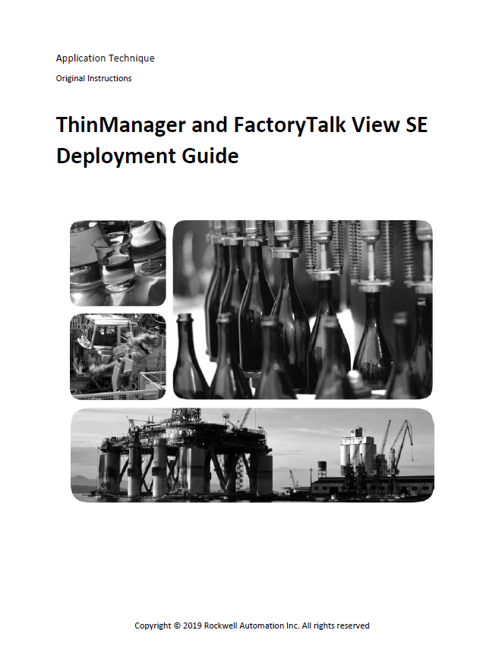
ThinManager Planning Guidance
Useful Material and Links
  ThinManager RAKB Table of Contents
  Deployment Guide with FT View SE
  Architecture Review FAQ
  Setting up a ThinManager System
  ThinManager and PXE Boot
  ThinManager Media
  ThinManager and Security Best Practices
  Supported Hardware
  Ports
  ThinManager Feature Support
  ThinManager and Active Directory Integration

Slide 5


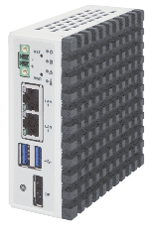

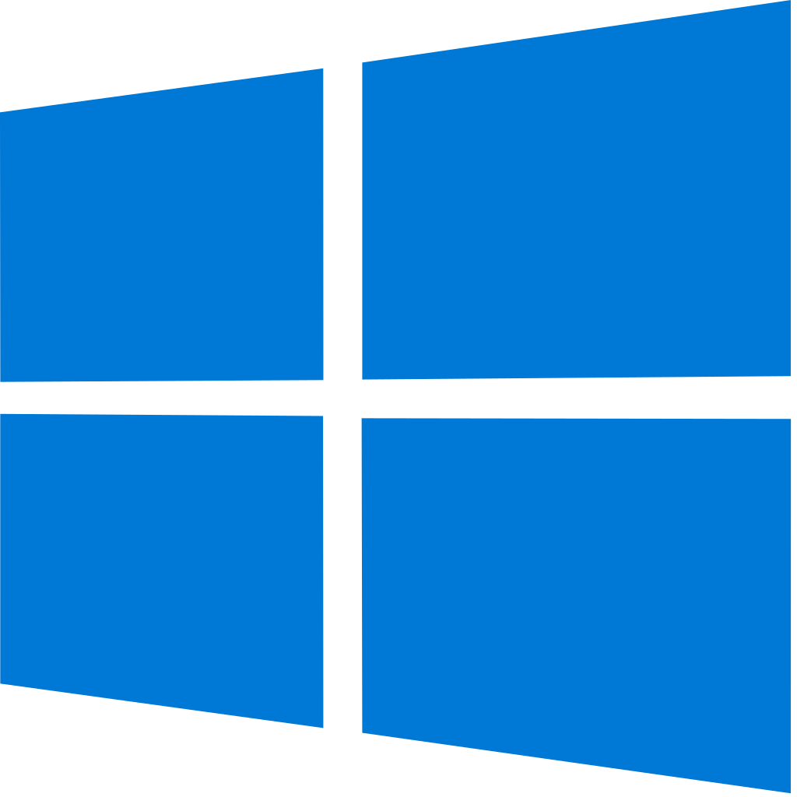












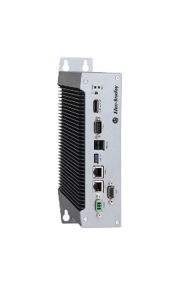

ThinManager®
Content Delivery and Device Management
Content Types
Configuration
Delivery
PanelView™ Plus
PanelView™ 5000
Devices
HMI
ERP
MES
CMMS™
User X
Users
Group X
Management
Role X
Web Content
Web Content
Locations
IP Camera
USB Camera
…AND MORE!
Hardware
ThinManager® provides secure configuration and delivery of content

Slide 6
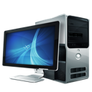
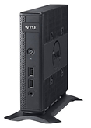
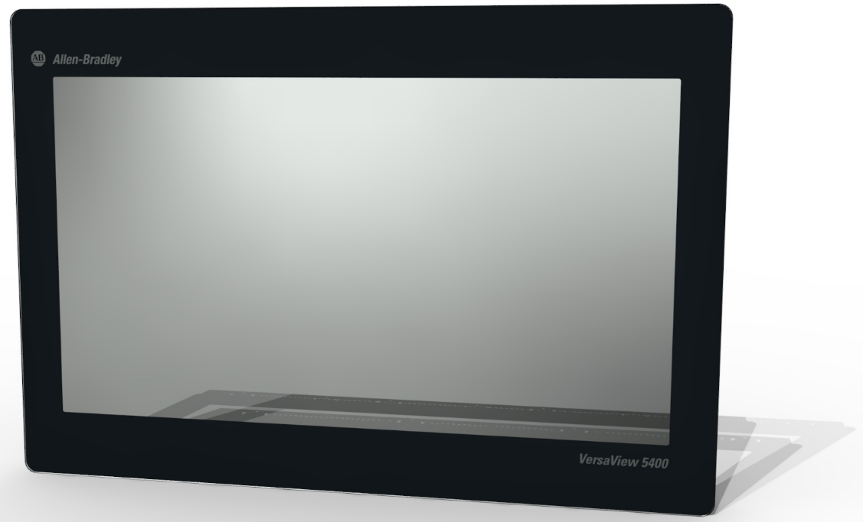
Types of ThinManager Client Hardware
ThinManager Compatible Plus
- Compatible Plus units are functionally the same as Compatible Units with the exception that they are specifically listed in the ThinManager TermCap to overcome hardware specific compatibility issues
ThinManager Compatible
-Intel x86 based computing hardware
-Must Issue DHCP/PXE request to obtain IP address and Boot Instructions
ThinManager Ready
-ThinManager BIOS extension
-Storage of Local IP Address and Boot Instructions
Good Better Best
ThinManager v11 supports UEFI hardware
https://kb.thinmanager.com/index.php/Supported_Hardware
Selection Considerations: CPU, RAM, GPU, Video Outputs, USB, Serial, Audio

Slide 7
What are ThinManager Clients (TMC)?
Features
WinTMC
  Application for Windows OS
Uses device’s OS
Provides similar functionality of a thin client terminal without a physical thin client
Licensed the same way
Use for mobility
Easy to install
iTMC
  Application for Apple OS
aTMC
  Application for Android devices
All download information found at https://downloads.thinmanager.com/

Slide 8
ThinManager Client Hardware using PXE
 |  | Source of PXE Response |  |  | ThinManager Redundancy Compatible
 |  | Client IP Address | Next Server IP Address*** | Boot File Name
PXE Configuration Options | Using Standard DHCP (Proxy) | DHCP | TM | TM | YES*
 | Using Standard DHCP with Boot Options | DHCP | DHCP | DHCP | NO** (Fully supported in ThinManager Ready)
 | Not Using Standard DCHP | TM | TM | TM | YES*
* Requires DHCP Helper to forward PXE request if clients are in different subnet than ThinManager server
**Redundancy is limited on firmware delivery; redundancy of relevance and other runtime features still present
***This indicates where the PXE Server is located. When Using DCHP with Boot Options, this is done on the DHCP Server

Slide 9
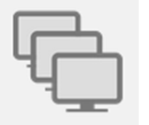
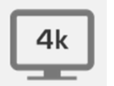

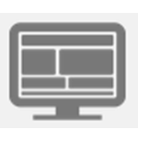
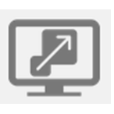
Display Client Definition
Content to be Delivered
Remote Desktop Services Display Clients
  Requires RDS Role to be installed and configured
  Using AppLink™ to restrict desktop access
Workstation Display Clients
  Requires RDP Protocol (1 to 1 relationship)
VNC Display Clients
  May require the installation of VNC on source OS
  PanelView Plus and PanelView 5000 terminals are ready
  Specify Interaction
Camera Display Clients (USB or IP)
Terminal Shadow Display Clients
  Specify Interaction
Container Host
  Firefox Container
MultiMonitor
Freeform layout
4K Resolution
Support for high resolution 4K monitors
Session Tiling
Tile up to a 5x5 grid of sessions
Virtual Screen
Up to 16 customizable segments
Session Scaling
Scale sessions up or down

Slide 10

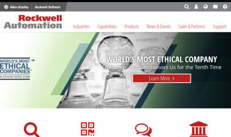
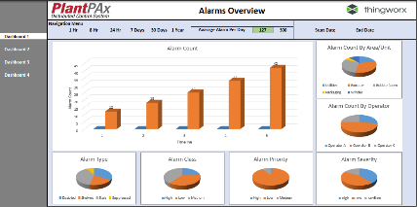
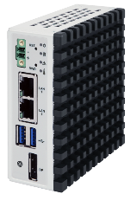
ThinManager 12 Container Host Display Client
ThinManager 12 features a container management system allowing web-based content to be delivered natively
WEB BROWSER
DISPLAY CLIENT
Web browser container managed by ThinManager docker host
  Removes RDS Deployment requirement for web applications
  Common platform to deploy applications natively
ThinManager
Remote Desktop Services
Web Browser
Data Servers
Web Servers
MES Servers
ViewPoint
NEW!
Docker Host
Container Management
Web Browser Container
*Deployment information found in Version 12 User Manual

Slide 11


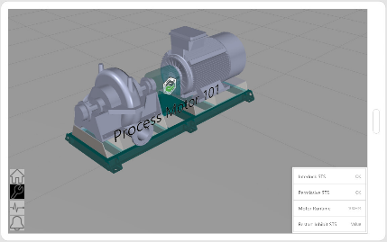
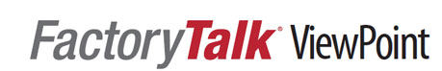
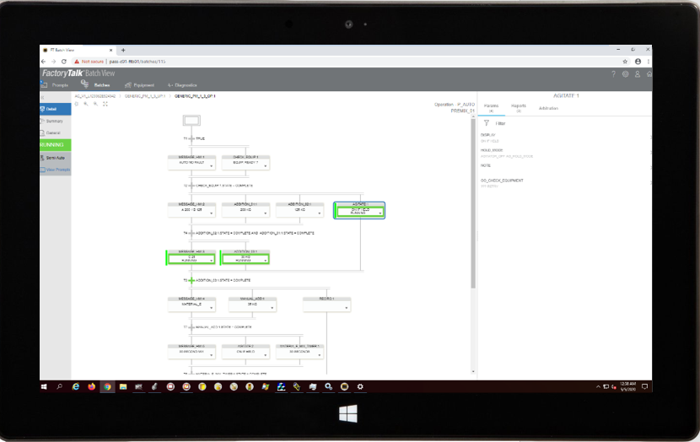
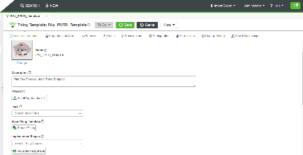
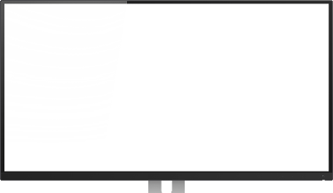
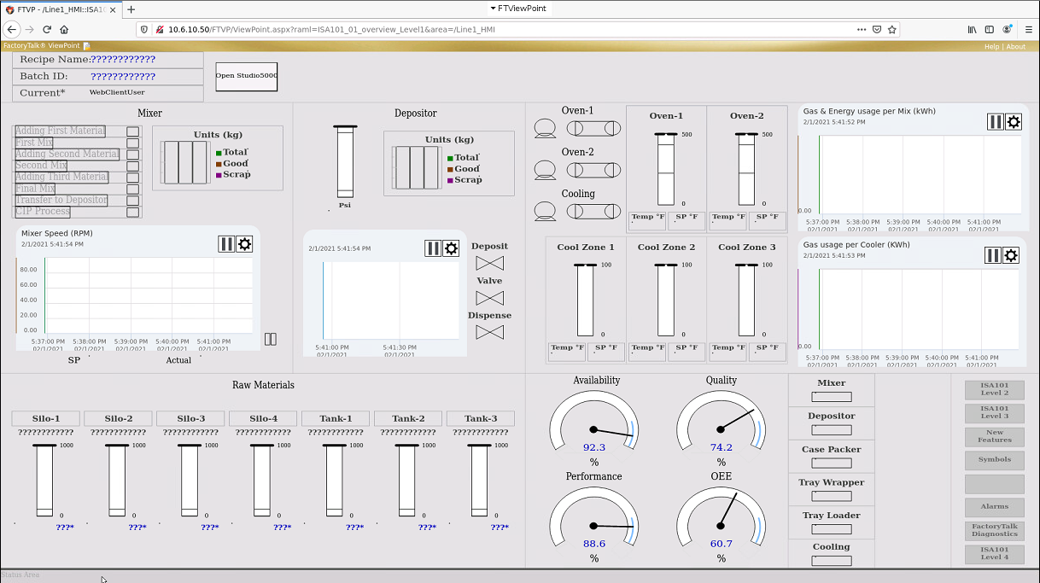

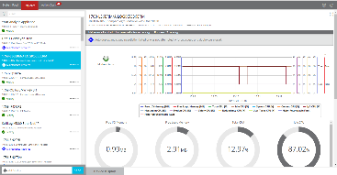
Where can the Web Browser Display Client be used Today?
Batch Mobile
Process Strategy Templates
Web based distributed HMI Solution
Alarm Dashboards
Action Card View
Web Browser Container

Slide 12
Licensing

Slide 13
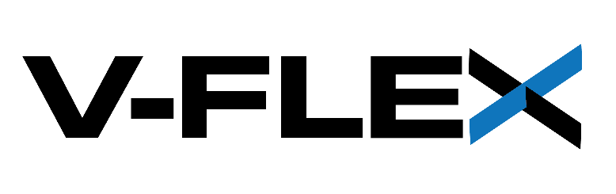
ThinManager® V-FLEX Licensing Overview
Available in both Subscription and Perpetual + Maintenance
ADVANTAGES OF V-FLEX LICENSING:
Central management of ThinManager® client connections.
Use across multiple facilities—no limitations on the number of locations, networks and servers.
Ability to purchase and add additional licenses only when and where they are needed with volume discount pricing.
This Redundancy Companion license is sold separately and cannot function independently since it is sold for a 50% reduced cost.
OVERVIEW
Deliver ThinManager® client connections with maximum flexibility on an as-needed basis to any of your facilities around the world.
ThinManager® V-FLEX licensing is a single ThinManager® XLr™ individual terminal connection license that can be purchased one-at-a-time in any quantity.
They can be deployed over an unlimited number of ThinServer™ pairs (primary/backup) at an unlimited number of locations on multiple networks.

Slide 14
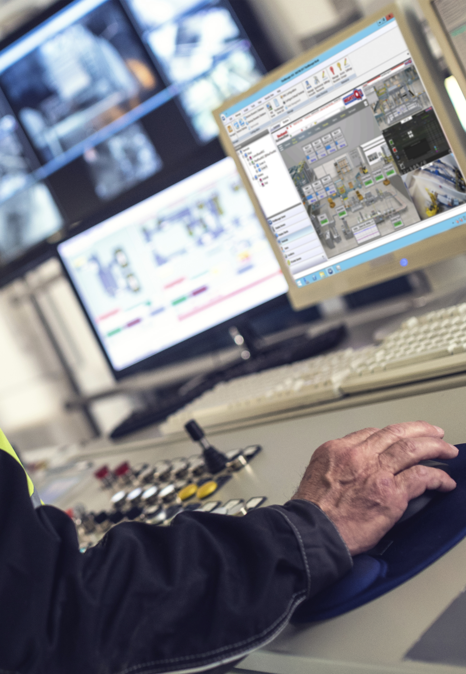




Step Forward from Legacy Licensing
Advantages
    V-FLEX model provides volume-based discounting on Software Maintenance
    Flexible deployment allows for segregation of ThinManager servers dictated by architecture requirements, not licensing model
    Standardize current implementations with future purchases on a consistent licensing model

Slide 15
Other Licensing Considerations
Remote Desktop Client Access Licenses (RDSCALs)
  There are 2 types available:
    Per User – each unique user session requires an RDSCAL
    Per Device – each device receiving a session requires an RDSCAL
  Per Device is generally more suitable for ThinManager deployments
  *Note: RDSCALs is different from Windows CALs. You need both!
  FactoryTalk Licensing
  ThinManager v11 and FactoryTalk View SE v11 introduce support for a single FactoryTalk View SE client license needed per ThinManager managed device.
    Supports terminals using multi-session capabilities (Tiling, Virtual Screens, Multimonitor)
    Supports terminals using RDS Failover capabilities (RDS High-Availability)
    For more information, refer to
    AID 1083982 - ThinManager and FTView SE Client Licensing
ThinManager and FactoryTalk View SE together offer a licensing model which differentiates the solution from other HMI vendors

Slide 16
FTViewSE & ThinManager Licensing Scenarios
Valid for FTA & TMA!
Location of client licenses:
FTVSE
TM
FTVSE
TM
HMI
RDS1
RDS2
View SE Client Licenses Required | Standard Failover | Instant Failover
FTVSE 11 & TM 11 | 4 | 4
FTVSE 10 & TM 10 | 8 | 8
FTVSE 10 & TM 11 | 8 | 8
FTVSE 11 & TM 10 | 8 | 8

Slide 17
FTViewSE & ThinManager Licensing Scenarios
Valid for FTA & TMA!
Location of client licenses:
FTVSE
TM
FTVSE
TM
FTVSE
TM
FTVSE
TM
HMI
RDS1
RDS2
HMI
RDS1
RDS2
View SE Client Licenses Required | Standard Failover | Instant Failover
FTVSE 11 & TM 11 | 4 | 4
FTVSE 10 & TM 10 | 8 | 8
FTVSE 10 & TM 11 | 8 | 8
FTVSE 11 & TM 10 | 8 | 8
View SE Client Licenses Required | Standard Failover | Instant Failover
FTVSE 11 & TM 11 | 1 | 1
FTVSE 10 & TM 10 | 8 | 8
FTVSE 10 & TM 11 | 8 | 8
FTVSE 11 & TM 10 | 8 | 8

Slide 18
FTViewSE & ThinManager Licensing Scenarios
Valid for FTA & TMA!
Location of client licenses:
FTVSE
TM
FTVSE
TM
FTVSE
TM
FTVSE
TM
FTVSE*
TM
TM
HMI
RDS1
RDS2
HMI
RDS1
RDS2
HMI
RDS1
RDS2
*This architecture represents a remote license server for the FTView SE clients and introduces an additional failure point into the architecture
View SE Client Licenses Required | Standard Failover | Instant Failover
FTVSE 11 & TM 11 | 4 | 4
FTVSE 10 & TM 10 | 8 | 8
FTVSE 10 & TM 11 | 8 | 8
FTVSE 11 & TM 10 | 8 | 8
View SE Client Licenses Required | Standard Failover | Instant Failover
FTVSE 11 & TM 11 | 1 | 1
FTVSE 10 & TM 10 | 8 | 8
FTVSE 10 & TM 11 | 8 | 8
FTVSE 11 & TM 10 | 8 | 8
View SE Client Licenses Required | Standard Failover | Instant Failover
FTVSE 11 & TM 11 | 4 | 4
FTVSE 10 & TM 10 | 4 | 8
FTVSE 10 & TM 11 | 4 | 8
FTVSE 11 & TM 10 | 4 | 8

Slide 19
Architecting a Managed Solution

Slide 20
ThinManager and High Availability
ThinServer and Remote Desktop Services
ThinManager Redundancy
  ThinManager Service Process
  Synchronization of ThinManager Configuration Database
  Capability to boot ThinManager Ready and ThinManager Compatible terminals
  Provision of terminal/user/location based content to thin clients
Remote Desktop Services Failover
  Remote Desktop Services Host Role
  Identical Windows Based Applications Installed
  Standard Failover – session launches on demand on secondary
  Instant Failover – sessions established on both servers
  Enforce Primary – Primary Designated to run when online

Slide 21
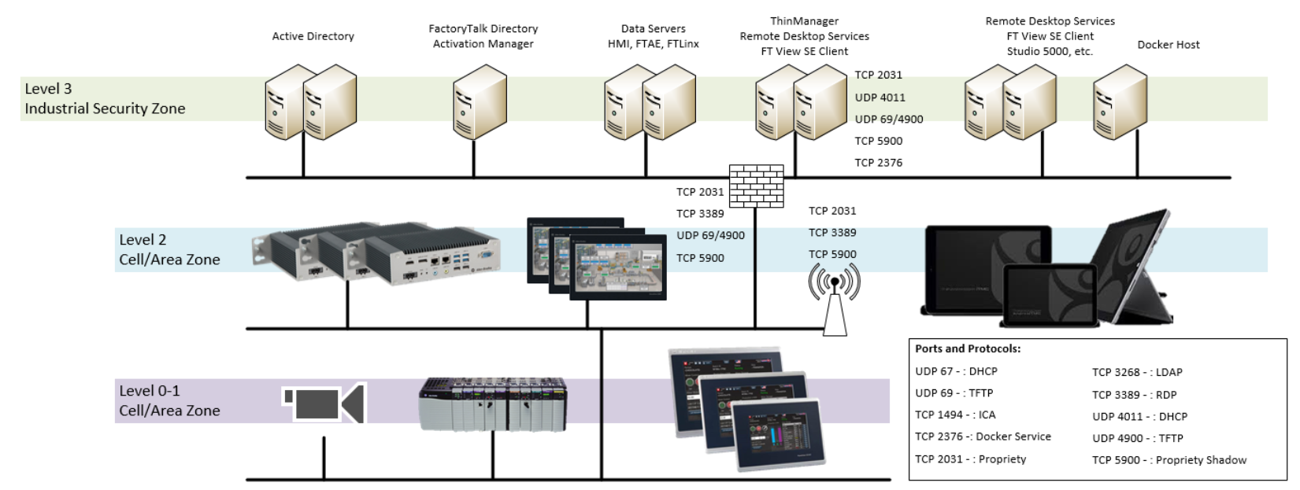
Sample Redundant Architecture (High Availability)

Slide 22
Architecture Scale Example
Architecture Example for 20 thin clients and Redundant system with Failover.
20 clients with FT ViewSE Client
Assumes 10 clients per server!
Failover and Redundancy
RDS1: Clients 1-10
RDS2: Clients 11-20
RDSF: Failover for 1-20
RDS, Client Applications, and ThinManager could be co-located
Redundant pair per system

Slide 23
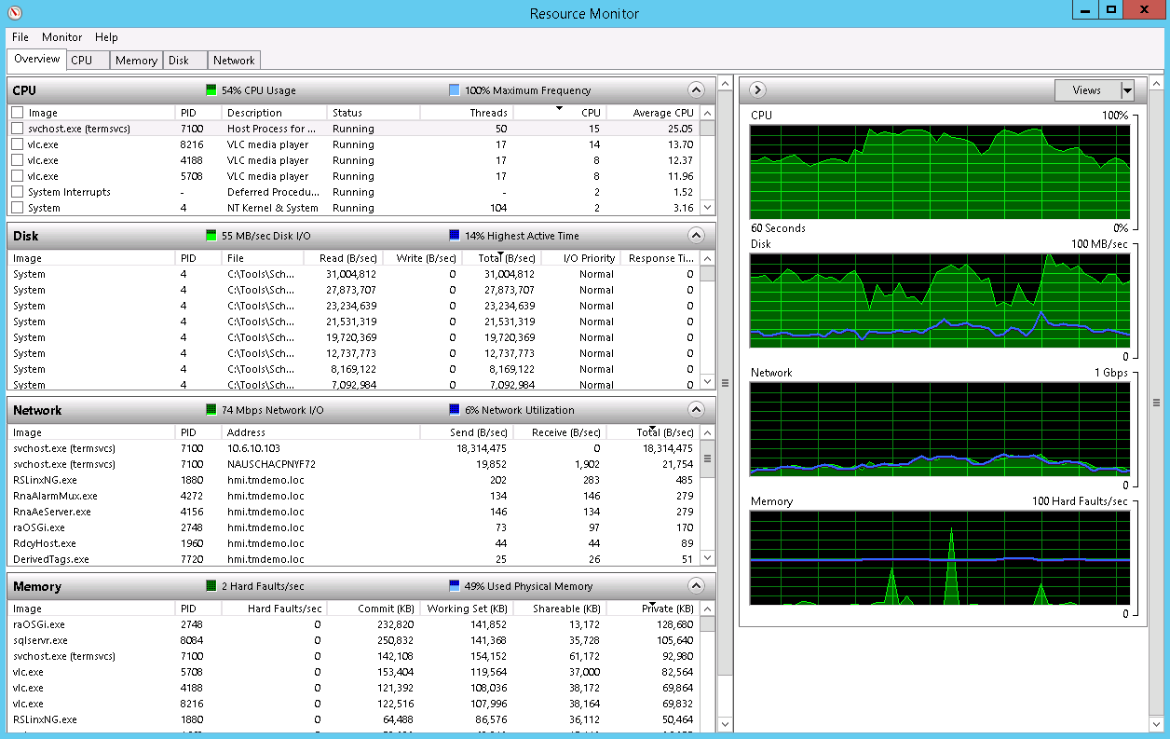
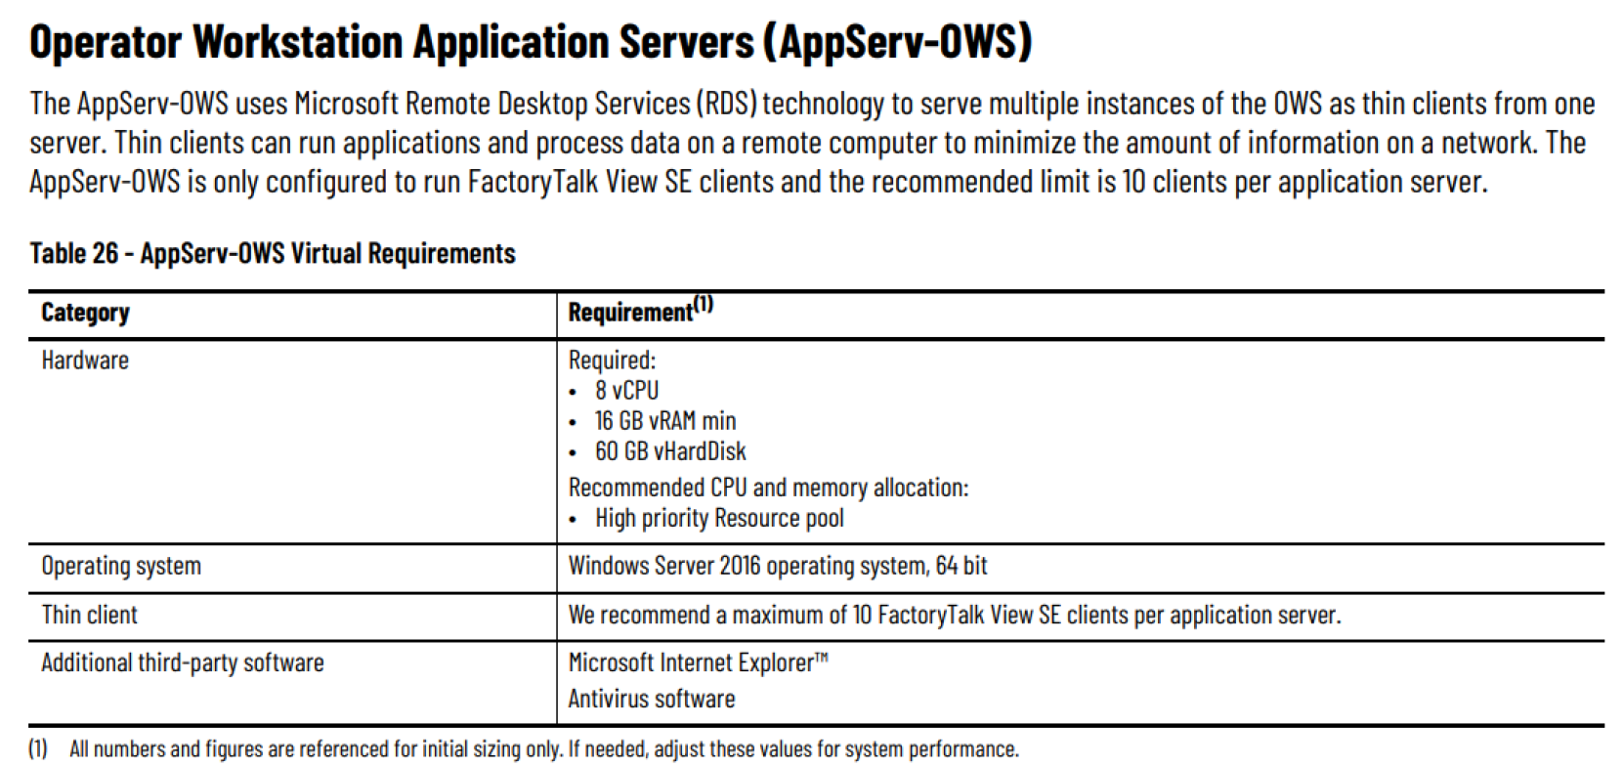
Remote Desktop Server Host Sizing
Size conservatively!

Slide 24
Sample Architecture Across IDMZ

Slide 25
Sample Architecture Across IDMZ
Benefits of this architecture
  Complete isolation of Enterprise and Industrial spaces for enhanced security
  No software installed and no data stored in the IDMZ
  Limited ports opened through firewalls
Limitations of this Architecture
  Cannot manage terminals on the opposite side of IDMZ
  Cannot shadow terminal on opposite side of IDMZ
Note: V-Flex Licensing remains the same regardless of how many ThinManager servers are deployed

Slide 26
Security and Networking

Slide 27
ThinManager Security
Safe and Secure Content Delivery
Relevance Users
  Active Directory Synchronization (1 AD Group or OU)
    Secure Password Management and Storage for service accounts
Access Groups and Permissions
  Restrict access to assets
Multifactor Authentication
  Password always needed to establish RDS session
  ADD Temporary or Permanent PIN, RFID Badge, Biometrics
Authentication Passthrough
  Requires v10+ of FactoryTalk View SE and ThinManager
  Add AD Users to ThinManager and FactoryTalk Directory
  Relevance User credentials natively passed to all FactoryTalk View SE sessions running on a terminal
For more information, refer to AID 1082369 - ThinManager and Security Best Practices

Slide 28
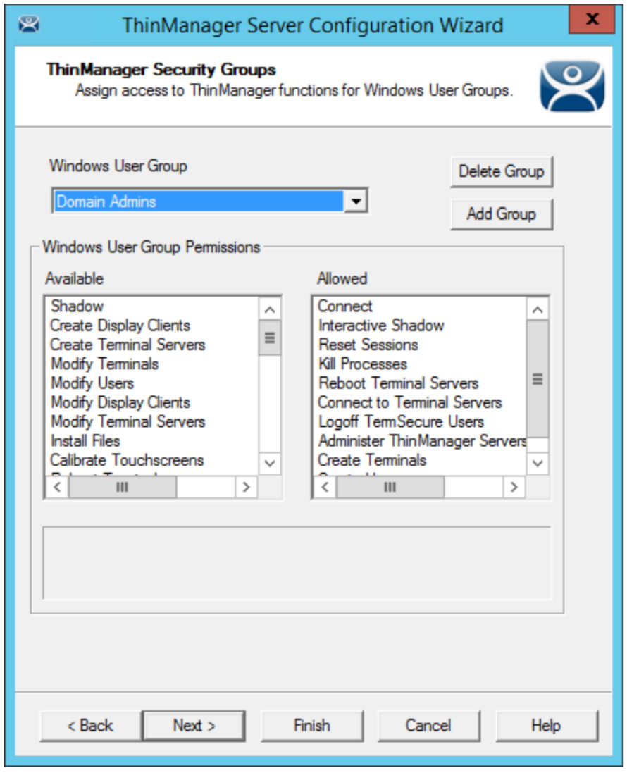
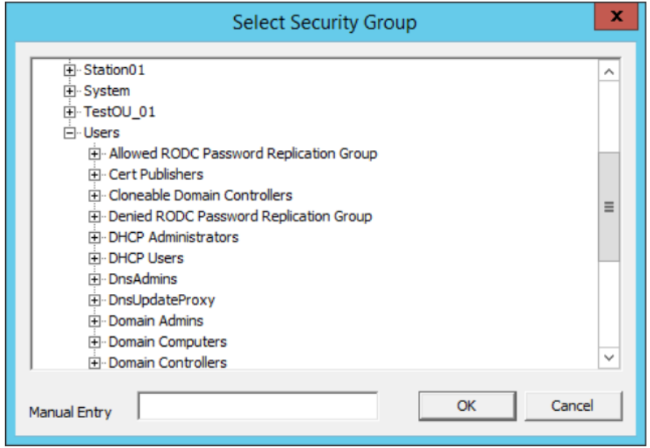
ThinManager Security Groups and Granular Permissions
Administrative Permissions and Ownership Responsibilities
Granular Permissions
Permissions assigned using ThinManager Security Groups
  Can be assigned for each site or globally
  Active Directory integrated groups for role assignment

Slide 29
Enhance and Simplify Security Initiatives
Reducing the Attack Surface
Using thin clients with ThinManager
The firmware – Extremely lightweight OS with only the necessary processes running
Only a means of connecting to content (no local data or storage)
USB/CD/DVD/floppy – external devices not enabled by default
Clients
Servers
ThinManager user terminals do not store local data and reduce your plant floor attack surface

Slide 30
Enhance and Simplify Security Initiatives
Reducing the Attack Surface
Application Centralization
Applications run on centralized servers not standalone PCs, more secure environments
Less OS’s
Established password-secured/encrypted protocols – RDP, VNC, streaming protocols
Encrypted RDP comms between source and client (TLS 1.2 negotiation)
Low port count
Clients
Servers
Clients only access content from centralized servers

Slide 31
ThinManager Communication Ports
Communication from Server to Client and Server to Server
Ports Used in a ThinManager deployment
Network issues are a great place to start troubleshooting in a ThinManager deployment
UDP 67 – DHCP, IP address delivery, ThinManager Compatible terminals
UDP 69 – TFTP, firmware delivery, ThinManager Compatible terminals
TCP 1758 – Multicast port, firmware delivery
TCP 2031 – Profile delivery, monitor connection, ThinServer synchronization
TCP 3389 – RDP, session communications
UDP 4900 – TFTP, firmware delivery, ThinManager Ready terminals
TCP 5900 – Shadowing port
TCP 2376 – Docker Service

Slide 32
Tips and Tricks

Slide 33
What are Modules?
Modules add thin client capabilities with peripheral devices
Networking
Redundant Ethernet Module
  Active/Standby
Second Ethernet Module
  Assign second IP address to terminal (Static or Dynamic)
  Prime Use Case – separate cameras network
User Interface
Key Block Module
  Block Windows Hotkeys
    Ctrl-Alt-Del
    Alt-F4
    Windows Key
    Alt-Tab
Touch Screen Modules
  15 Serial Touch Drivers
  Universal USB Driver
Performance
RDP Experience Module
  Stagger Multisession establishment
USB Card Reader
  Support for readers across multiple vendors
MultiSession Screen Saver Module
  Set display clients to cycle while terminal is idle

Slide 34
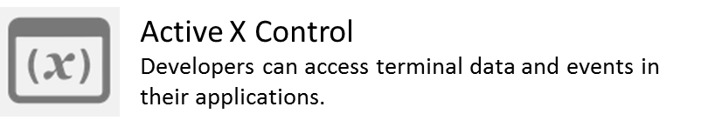
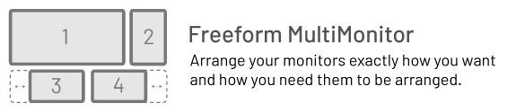
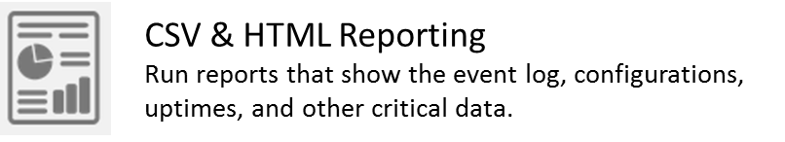
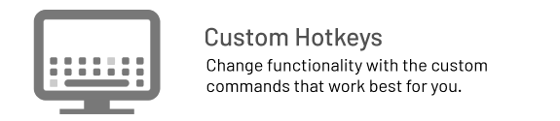

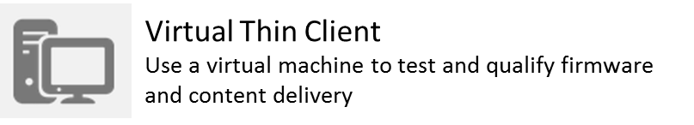

More Tools and Features

Slide 35
Supplemental Slides

Slide 36
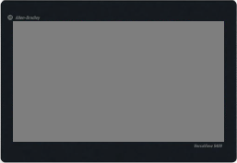

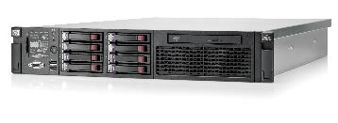
Thin Client is Powered On
ThinManager terminal is powered on

Slide 37
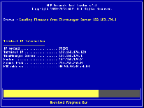
ThinManager Firmware is Delivered
ThinManager firmware is delivered to terminal
The ThinManager firmware is delivered by the ThinServer service
The firmware is the ThinManager OS
It is delivered to a thin client right at boot time
Firmware

Slide 38
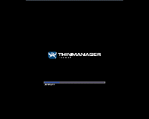
Terminal Profile is Delivered
ThinManager Terminal Profile delivered
The Terminal Profile is also delivered by the ThinServer service
The Terminal Profile defines the terminal content to deliver
It also defines how to display or visualize the content
Modules for touchscreens, badge readers, etc. can also be added to the terminal profile
Profile

Slide 39
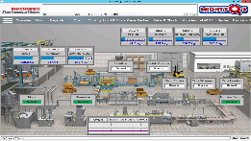
Terminal Profile Content Delivered
Content assigned to Terminal Profile delivered
ThinManager can deliver content in 3 different ways:
  Assign content to the terminal
  Assign content to a user or user role
  Assign content to a location (Relevance)
Terminal Content

Slide 40
High Availability
FactoryTalk View SE Redundancy:
Synchronized servers providing the application content to client software. In the event the designated primary server is offline, the secondary server will provide the data communication to the controllers, application information, and alarming information.
ThinManager Redundancy:
Similar to FTView SE redundancy, this is a synchronized database the has the ability to deliver the terminal profile, relevance information, and firmware (ThinManager OS) to the thin clients. Either ThinManager server can act as the Master and the Master is not designated on installation.
ThinManager Failover:
Failover is the configuration of the application to be delivered (in this case, FactoryTalk View SE) on two (or more) Remote Desktop Server Hosts. In the event a RDHost is unavailable, the application can failover to run on another RDHost such that plant floor visualization is not lost. There are two forms of failover: instant and standard. Instant Failover is where the application is running on both RDHost servers and when a failover occurs, the loss of visualization is roughly 1-2 seconds. Standard failover has a session connection established, but the application is not yet initialized on the failover RDHost. In this case, the loss of plant floor visualization is roughly 15-20 seconds in the case of FactoryTalk View SE (the time it takes to launch and load the application). The primary consideration for the difference between the two is resource consumption and server load. Instant failover will consume more resources on the hosts. This decision does not have to be made globally, and can be made on a thin client to thin client basis. There is also no licensing consideration with Instant vs. Standard failover in the latest product releases.
ThinManager SmartSession:
SmartSession is the ability for ThinManager to decide which server is least heavily loaded and launch any new sessions on the least heavily loaded server. This feature is simple to configure and maintain from inside the ThinManager user interface. SmartSession will not dynamically move sessions if a server is too heavily loaded. This is something that we often see the OT side manage.
Remote Desktop Load Balancing:
Microsoft Remote Desktop includes the ability for multiple servers to be configured in a pool and to have the Connection Broker component of the Windows deployment manage and dynamically move sessions if hosts become too heavily loaded. This typically requires IT support and understanding of proper Remote Desktop Services deployments. Load balancing and SmartSession do not both need to be used, it is one or the other.
Firmware
Terminal Content
Firmware
Terminal Content

Slide 41
How to Activate ThinManager
How to activate ThinManager with FactoryTalk Activation (custhelp.com)
ID: QA41542 | Access Levels: Everyone
How to activate ThinManager with FactoryTalk Activation
Managing and Activating ThinManager V-FLEX Licensing (custhelp.com)
ID: IN10630 | Access Levels: Everyone
Managing and Activating ThinManager V-FLEX Licensing

